Slide 1
Walmart Superstore Sales Analysis
BY
ABISHEK.S

Slide 2
Table of Contents
Business Task
Data Sources
Data Cleaning and Manipulation
Visualizations and Key Findings
Recommendations

Slide 3
Business Task
The primary business task is to analyze Walmart Superstore sales data to gain insights into performance and identify opportunities for growth by creating interactive reports and dashboards using Power BI.

Slide 4
Data Sources
List of Data Sources:
Source 1: Bike usage logs (Walmart.csv)
Data Acquisition:
Data was collected through Google Drive including information on products, customers, stores, and transactions.

Slide 5
Data Cleaning and Manipulation
Cleaning Processes:
Handling Date Formats:
Inconsistent Date Formats: Dates initially in mixed formats, with some in numerical form and others in text form, were identified.
Standardization: All dates were standardized and converted into a consistent, appropriate date format.
Data Manipulation:
Creating New Variables:
Days Column: A new column for days was created to represent the day of the week for each transaction.
Delivery Date Difference: A new variable was created to calculate the difference between delivery dates for each order.

Slide 6
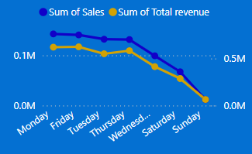
Visualizations and Key Findings
Visualization 1: Daily Sales and Total Revenue by Order Date

Slide 7
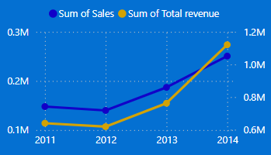
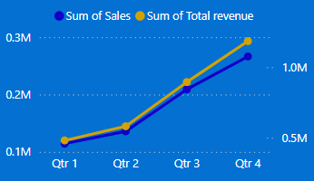
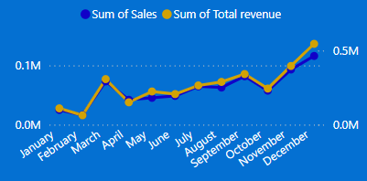
Visualizations and Key Findings
Visualization 2: Sales and Total Revenue by Month, Quarter, Year

Slide 8
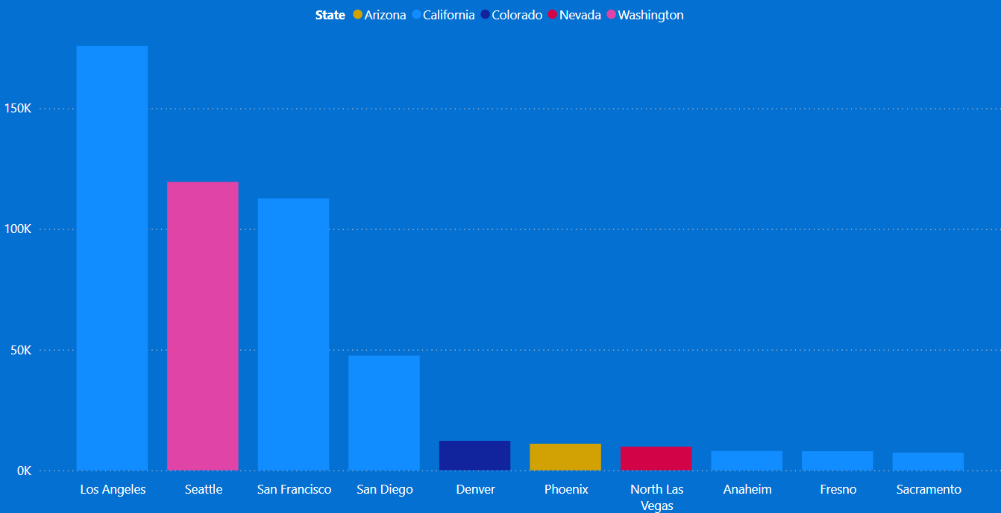
Visualizations and Key Findings
Visualization 3: Top 10 City Sales Summary by State

Slide 9
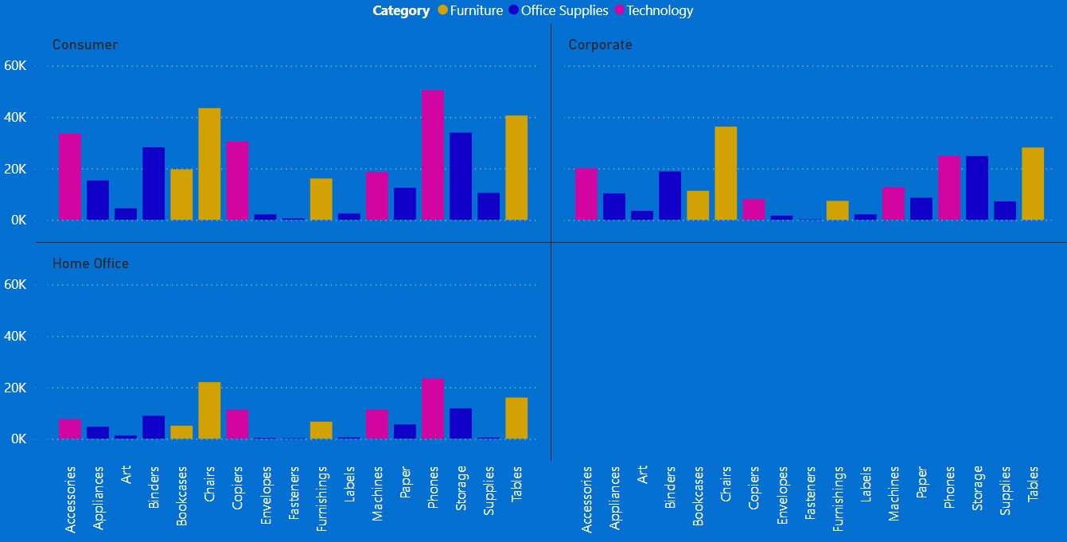
Visualizations and Key Findings
Visualization 4: Sales by Sub-Category, Category, and Segment
Analysis of start and end stations based on rider pick-up and drop-off locations reveals patterns in ride destinations.

Slide 10
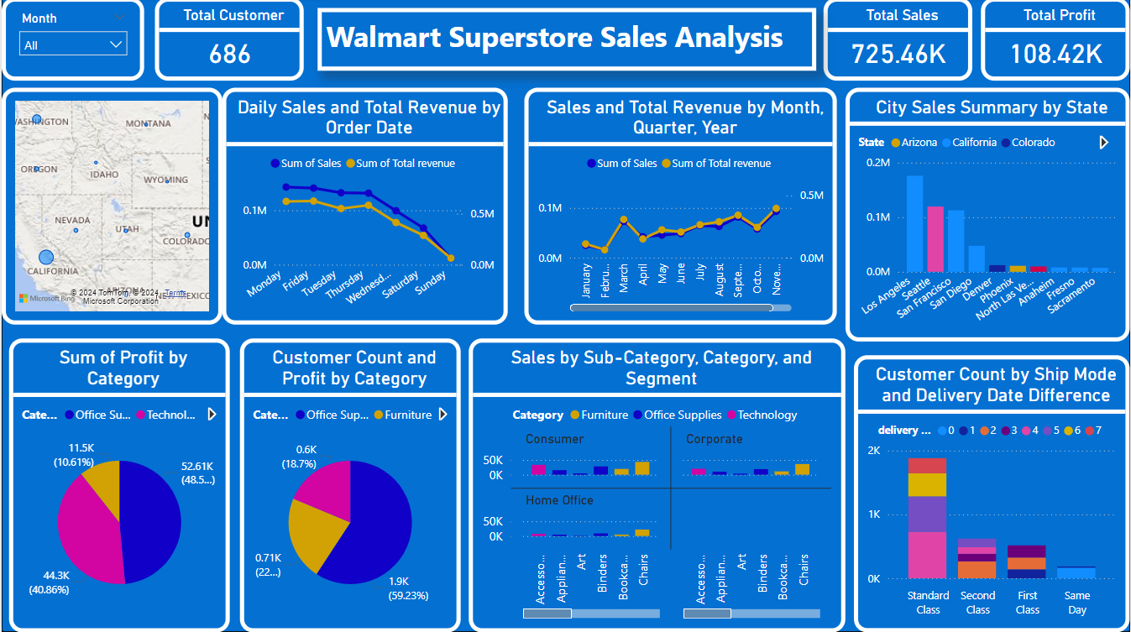
Visualizations and Key Findings
Visualization 5: Walmart Superstore Sales Analysis Dashboard

Slide 11
Recommendations
Recommendation 1: Increase Weekend Sales
Based on Analysis: Sales data indicates that Walmart Superstore experiences lower sales on weekends (Saturday and Sunday).
Expected Outcome: Implement targeted marketing campaigns and promotions during weekends to attract more customers and boost sales.

Slide 12
Recommendations
Recommendation 2: Boost Sales During Low Months
Based on Analysis: The sum of sales and revenue is high in December but very low in January and February.
Expected Outcome: Implement post-holiday promotions and targeted marketing campaigns in January and February to sustain customer engagement and increase sales during these months.

Slide 13
Recommendations
Recommendation 3: Enhancing Sales Across States
Based on Analysis: Among the 11 states, California has higher sales in its cities compared to other states.
Expected Outcome: Implement targeted marketing campaigns and promotions to further boost sales in California. Additionally, analyze successful strategies in California and adapt them to improve sales in other states.

Slide 14
Recommendations
Recommendation 4: Improving Standard Class Shipping
Based on Analysis: Standard Class shipping mode at Walmart has the highest number of customers, but the delivery days are longer compared to other shipping modes. This extended delivery time may affect customer satisfaction and deter repeat purchases.
Expected Outcome: Implement strategies to reduce delivery days for Standard Class shipping. By enhancing the efficiency of this shipping mode, Walmart can improve customer satisfaction and sales. Additionally, encouraging customers to shift to same-day delivery options can provide faster service and further boost sales.
Provide exclusive offers and discounts for customers who choose faster shipping methods.

